Slide 1



Kirknewton Solar and BESS Farm
Presentation
16 June 2025

Slide 2
Agenda
Introduction to BLC Energy Ltd & Octopus Renewable Infrastructure Fund
Why Solar?
Why Kirknewton?
Project Information
Ongoing Activities
Timeline
Community Engagement
Community Benefit
Next Steps
Questions & Answers

Slide 3
BLC Energy Ltd & Octopus Renewable Infrastructure Trust (ORIT)
BLC Energy was set up in 2022 to develop solar and BESS projects in the UK. The 3 partners have over 60 years experience of developing renewable energy projects and have secured planning consent for 3 solar projects in Scotland.
We are a Scottish company based in Perthshire with offices and team members in Aberuthven and Edinburgh.
2 partners also, directors in SLR a leading environmental and engineering consultancy with 4000 staff, will be providing specialist input into the planning process
We are currently developing 11 Solar and Bess projects throughout the UK of which 5 are in Scotland
In 2023 we entered into a development partnership agreement with Octopus Energy (via Octopus Renewable Infrastructure Trust- ORIT) and work with them on an exclusive basis.

Slide 4
BLC Energy Ltd & Octopus Renewable Infrastructure Trust (ORIT)
Octopus Renewable Infrastructure Trust (ORIT) is one of the funds managed by Octopus Energy Generation dedicated to operating renewable energy projects in the UK, Europe and Australia.
ORIT has a market capitalisation of £378m and as part of the Octopus Energy Generation group, has £6.7bn assets under management and a total generating capacity of 802MW (47% of which is Solar) This equates to 362,000 homes powered by its renewable energy each year
Octopus Energy is now the largest domestic energy supplier in the UK.

Slide 5
Why Solar?
It is the cheapest and fastest way to create new energy production in the UK.
Provides Scotland and UK with better energy security from local generation
Dependable generation and proven technology
Does not need any Govt support to build or operate- no follow on cost to consumers
Has minimum impact on land, environment and neighbours.
Has potential to significantly improve local biodiversity and soil health

Slide 6
Why Kirknewton?
No obvious environmental constraints on the site- no designations
Viable grid connection to Currie via underground cabling
Access directly off public road with minimal disruption to local community
Predominantly Grade 3 & 4 agricultural land classification
Opportunity to buffer from neighbouring properties
Supports Government targets for both Renewable Energy and Solar Generation

Slide 7
Project Information
40MW Solar, 9MW Battery grid connection to Currie GSP
c51k MWh generation or c51m units of electricity each year (equivalent to annual electricity needs of 18,888 houses- Livingston-19,000 in 2022 Census)
Current design based on 700w panels and 2MWh battery
Application will go to the West Lothian Council as under 50MW

Slide 8
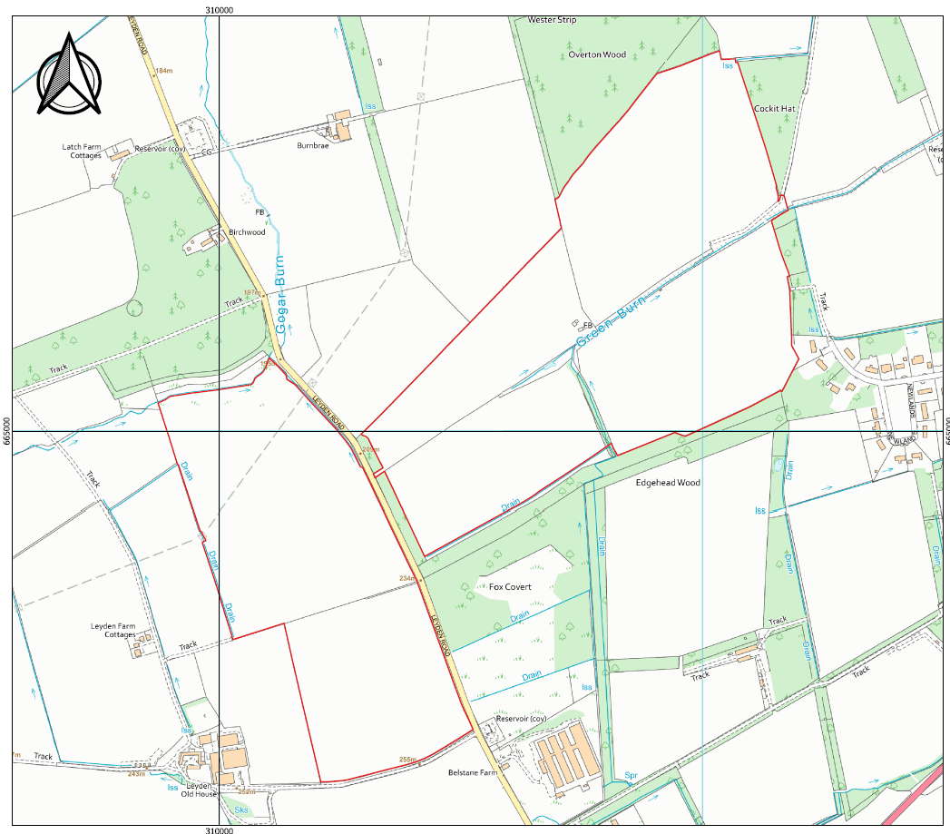
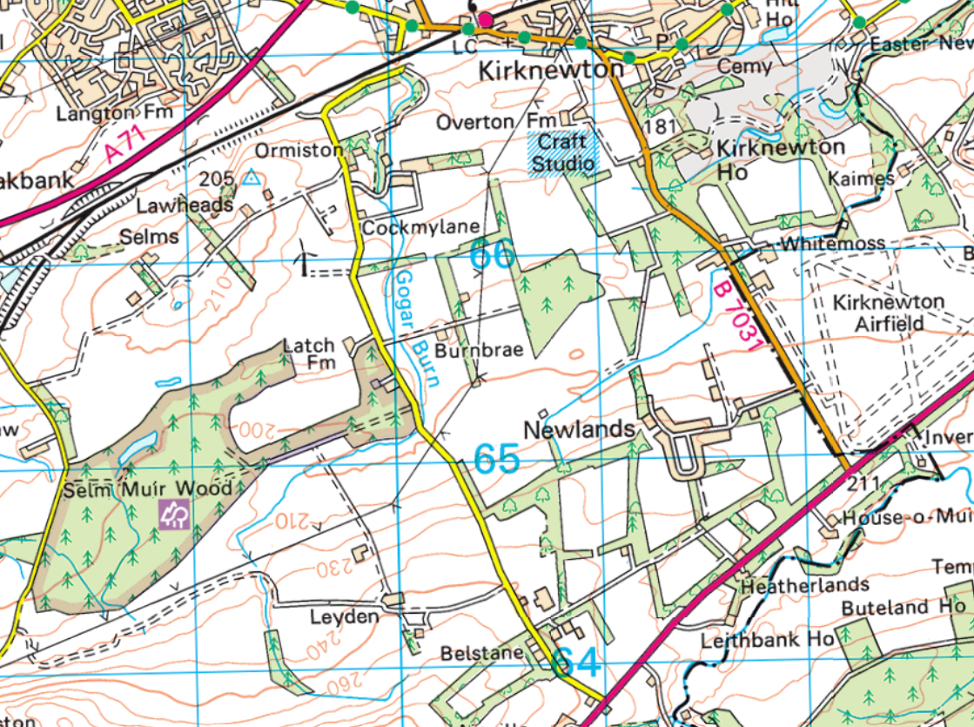
Project Location

Slide 9
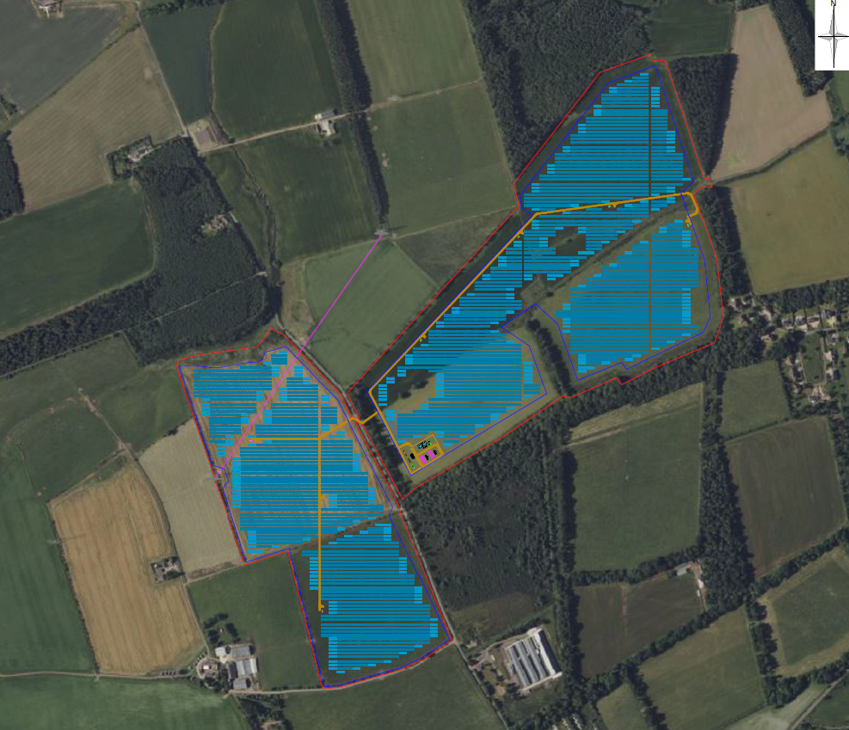
Starting Project Design

Slide 10
Ongoing Activities
Environmental studies March - October 25
Design Freeze Oct 25
1st Public Exhibition June 2025
2nd Public Exhibition October/ November 2025
Planning submission to W Lothian Council November- December 2025

Slide 11
Community Engagement
Community Council – Kirknewton.
As it is a major application to W Lothian Council, 2 public exhibitions are required at least 14 days apart- these will be advertised in the press, via the website, via the CC & by a local mailshot
  1st exhibition June 2025.
  2nd exhibition will be once final design is fixed and will show project plans, environmental studies, visualisations, 3D model of the project in the local area etc. Feedback forms will be provided. Suggested date October/November 2025
Web pages will be created to provide information on the project, dates of key meetings, etc.
Will engage with other local interest groups

Slide 12
Community Benefit
BLC Energy & ORIT will set up a community benefit fund to support local initiatives in the area.
The design and value of this fund to be worked on with the CB working group
These funds are not linked to the planning determination in any way.
Community Benefit good guidance is being prepared by Solar Energy UK and once published will be forwarded to the CB working group. It is likely to suggest a minimum donation of £400 per Solar MW per annum for the duration of the project life.
BLC Energy & ORIT would like to offer £500 per MW per annum split into 2 funds. One to support local projects, one to be given as grants to local households struggling with cost of living increases, loss of winter fuel payment etc
Also looking to help fund air source heat pumps for the 7 community housing for elderly residents.

Slide 13
Next Steps
Environmental Surveys
Public Exhibition June 2025
Review of Feedback
Report back to Community Council

Slide 14
Questions & Answers

Slide 15
Thank you
BLC Energy Ltd www.blcenergy.com info@blcenergy.com
Tel: 0131 3804985

